Slide 1


UG PROJECT 2020-21 :: VIVA-VOCE
BATCH - B9
FIRST RESPONSE DRONE
Supervisor
Dr. S. GANESH VAIDYANATHAN M.E., Ph.D.
Principal, SVCE
Members of students:
S. Prem Raj (Reg. No.: 170701101)
S. Lokesh (Reg. No.: 170701074)
SV. Kumaran (Reg. No.: 170701071)

Slide 2
PROBLEM STATEMENT
An emergency/response vehicle is any vehicle that is designated to respond to an emergency in a life-threatening situation. The conventional emergency/response vehicles have been our main preference for all these years, but the main draw-back is the wait time. Studies show that in India the average time for a response vehicle to reach the scene is about 15 minutes. This is mainly because of the extreme population density and the poor traffic management. With drones this delay can be reduced down to a significant amount. Our aim is to aid and support Civil Service Departments such as Medical Department, Fire and Rescue and Police Department.

Slide 3
LITERATURE SURVEY
Piotr Kardasz, Jacek Doskocz, Mateusz Hejduk, Paweł Wiejkut and Hubert Zarzycki, “Drones and Possibilities of Their Using ” This paper proposes the different methodologies used for the construction of drones and their elements such as frame, propellers, engine, system of power, electronic control and communication system. The paper also discusses about the danger of using UAVs, which is due to the limited power supply, damage caused by weather conditions, hitting an obstacle, discharge from batteries if there is any fault, danger of drone falling from a height due to battery failure. The paper overall discusses about the construction and risks in practicing an autonomous drone in civilian sectors.
Anna Konert, Jacek Smereka, and Lukasz Szarpak, “The Use of Drones in Emergency Medicine: Practical and Legal Aspects” This paper discusses about how air transport is widely used in military and civil emergency medicine owing to speed of action, lack of restrictions characteristic of ground vehicles and the ability to reach distant, otherwise inaccessible places. The paper talks about how drones carry loads at several hundred meters above ground. It also explains about the survey made with blood transport to urban areas with drones and how there is no loss in platelet counts, RBC count and temperature. It explains about how drones can be used in Beyond Visual Line of Sight (BVLOS) and discusses about how various countries are implementing tasks with drones.

Slide 4
LITERATURE SURVEY
Kyle Stelmack,”Weaponized Police Drones and Their Effect on Police Use of Force” Here they discuss about how unlikely an actual drone with lethal weaponry will rise, and how non-lethal weapons systems being attached to police drones is not out of the realm of possibility. Weaponry like fire tasers, beanbags also known as “Stun Batons” are suggested to be used. They also discuss about weaponry designs, which are similar to paint ball barrels which are capable of firing 20- 30 balls per second, and how these balls are to be replaced or filled with pepper spray, coloured dye or any solid plastic bullets and how the drone should also be equipped with blinding lasers. They also have stated about ‘Skunk Riot Control Copter’ which can fire up to 80 balls per second. They also have discussed about having a thermal camera, a full HD colour camera and a telemetry for long distance functions, including a real-time video link. They also strongly suggest that using drones would be of a great advantage to the department, due to the response time and limitations of human interaction towards the situation and how drones will move beyond strictly surveillance uses and move to intervention in situations on the ground.

Slide 5
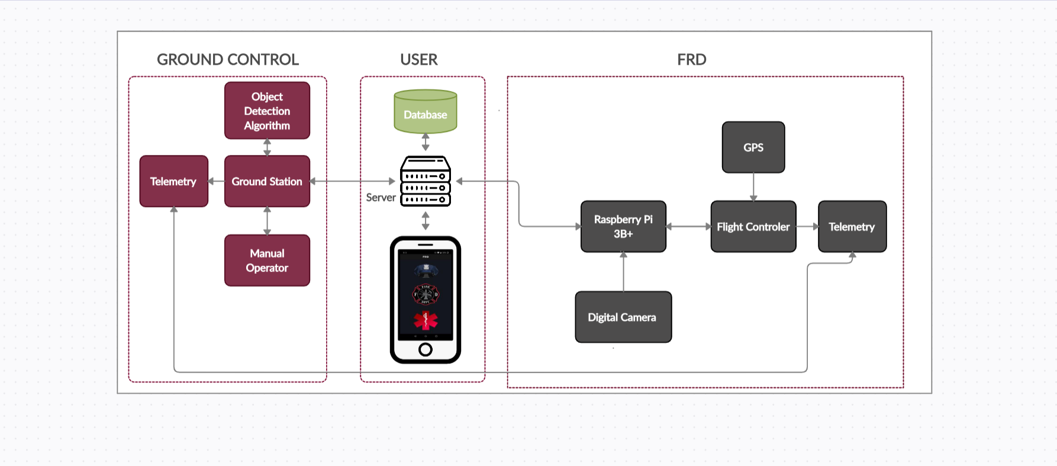
FRD ARCHITECTURE

Slide 6
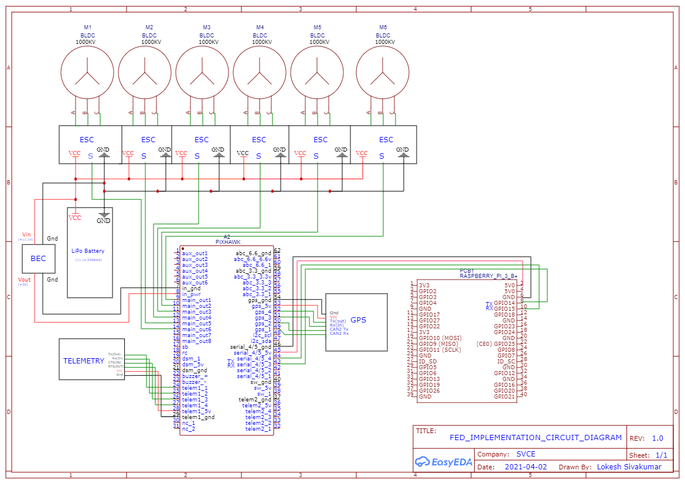
IMPLEMENTATION DIAGRAM

Slide 7
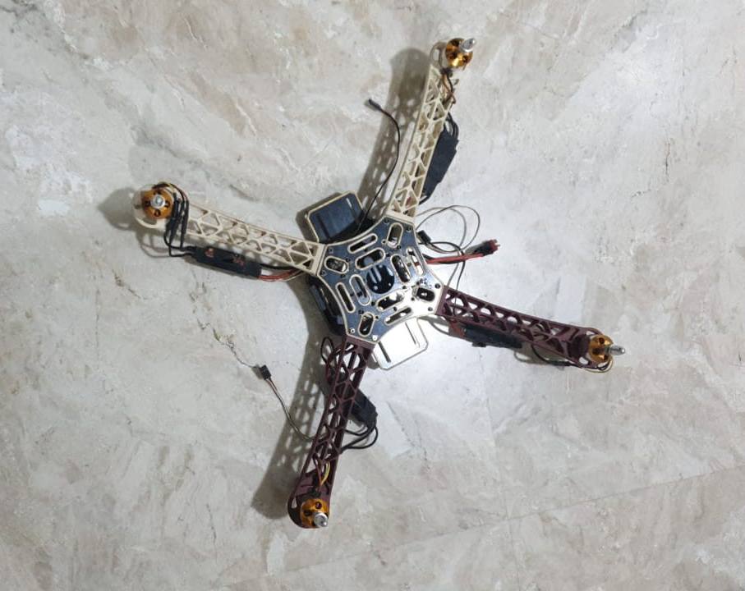
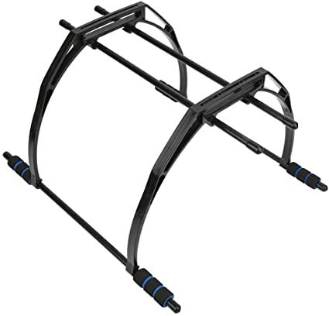
RESULTS
FRD QUADCOPTER

Slide 8
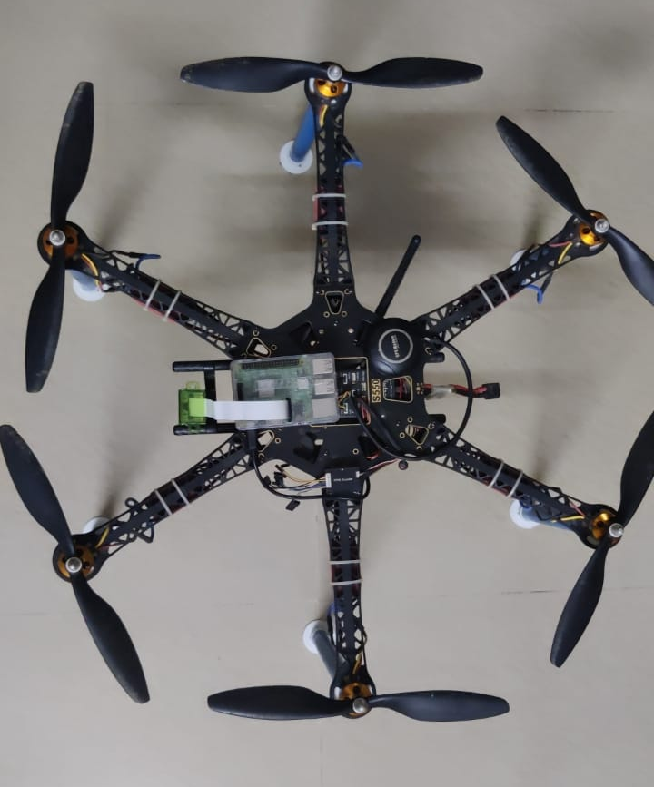
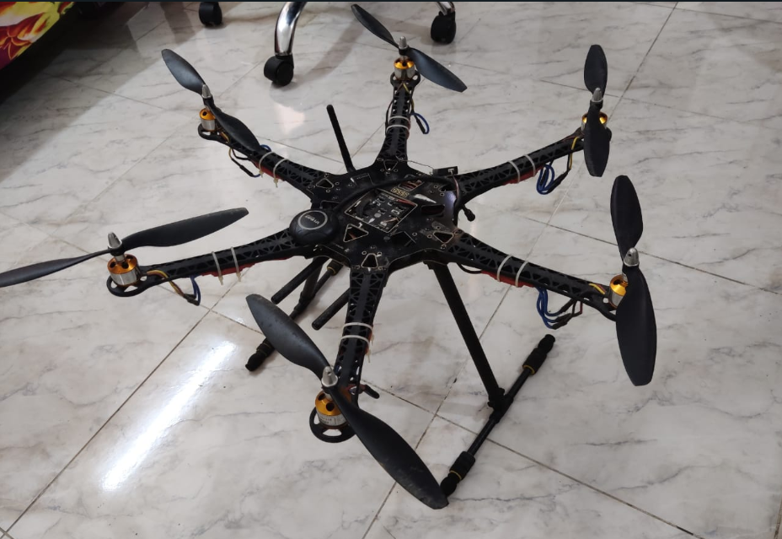
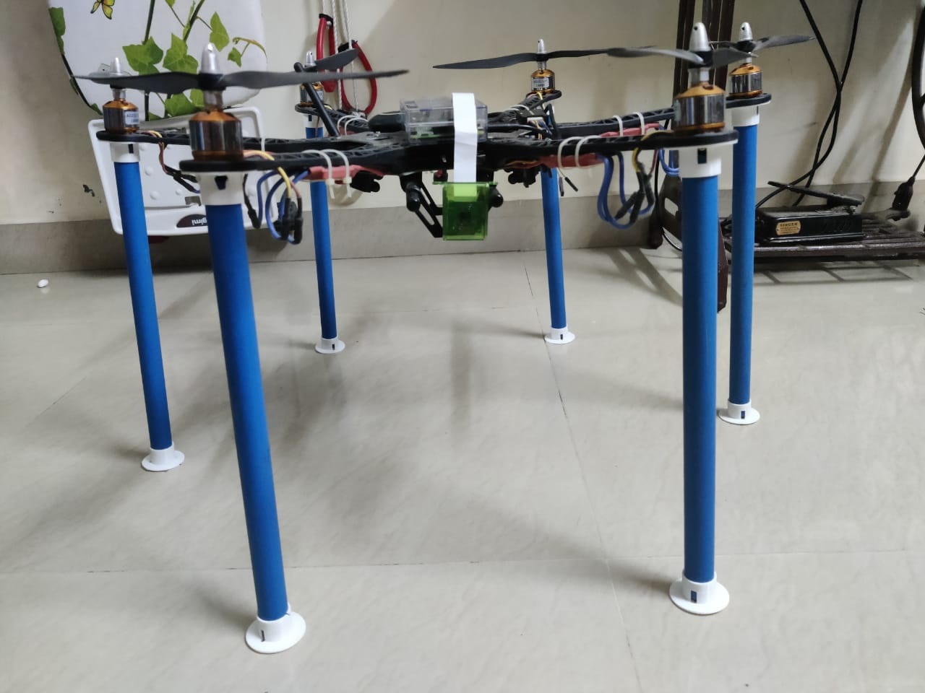
RESULTS
FRD HEXACOPTER
Top View (OLD)
Side View (New)
Top View (New)

Slide 9
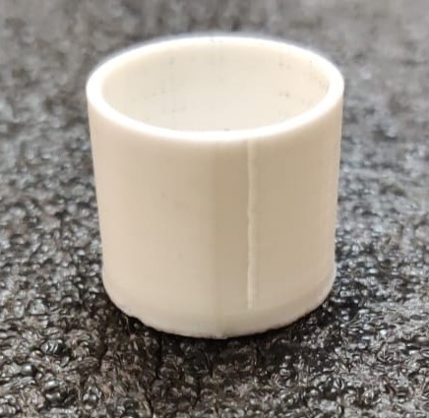
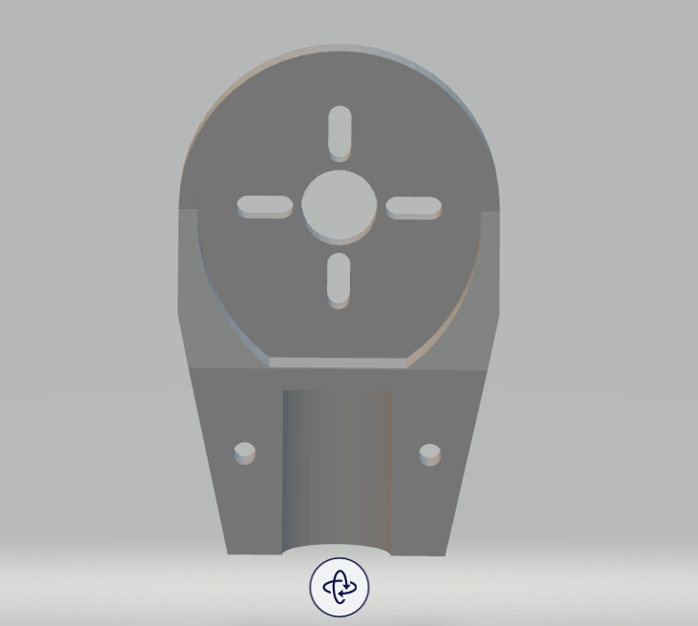

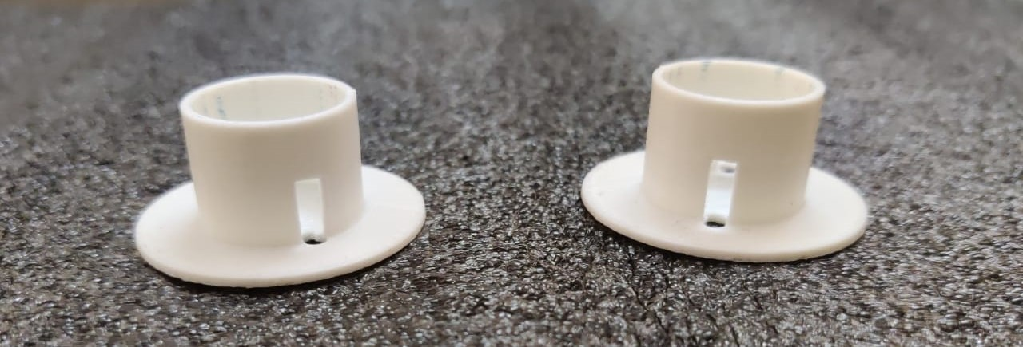
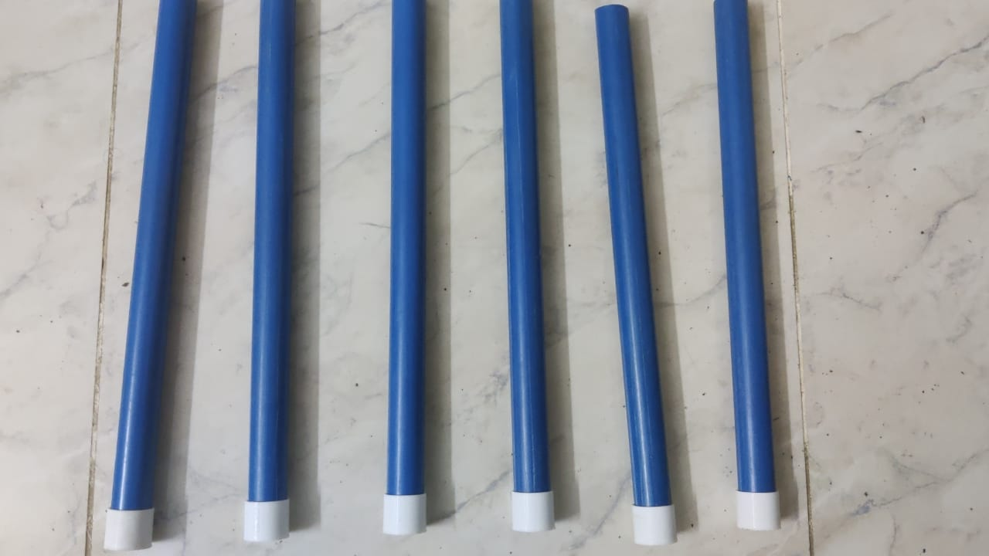
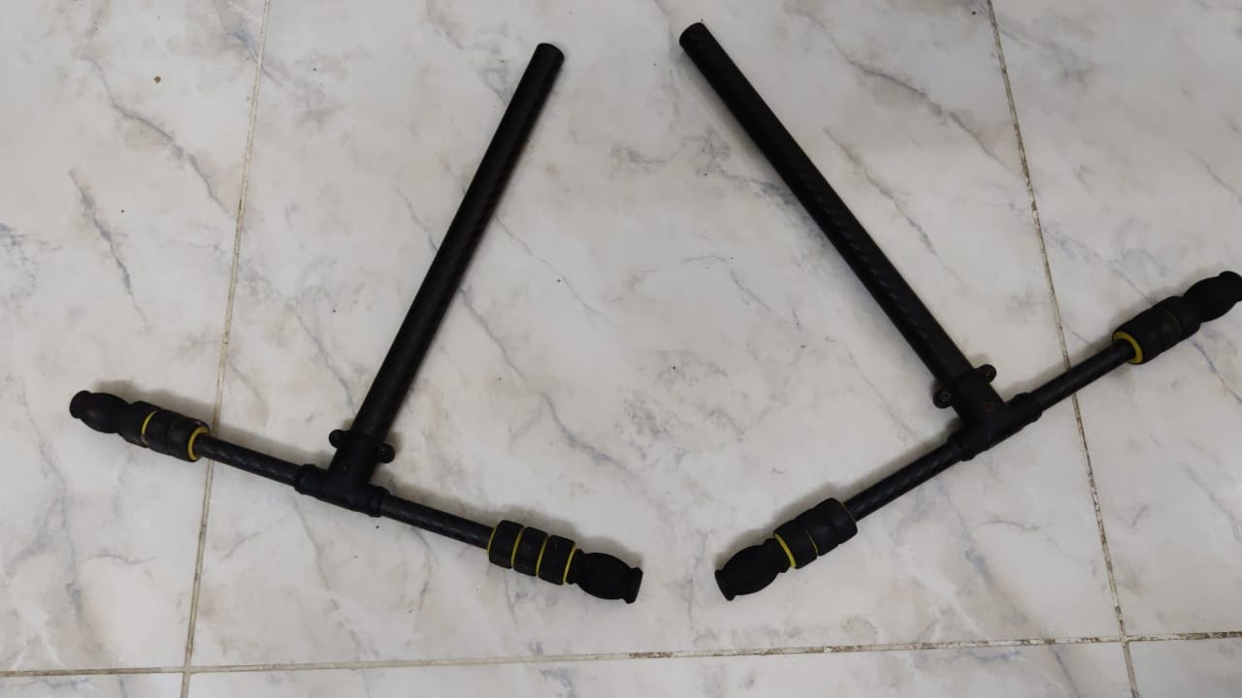
RESULTS
FRD LANDING GEAR
3D MODEL
Top
Bottom
100 g ( Each )
30 g ( Each )

Slide 10
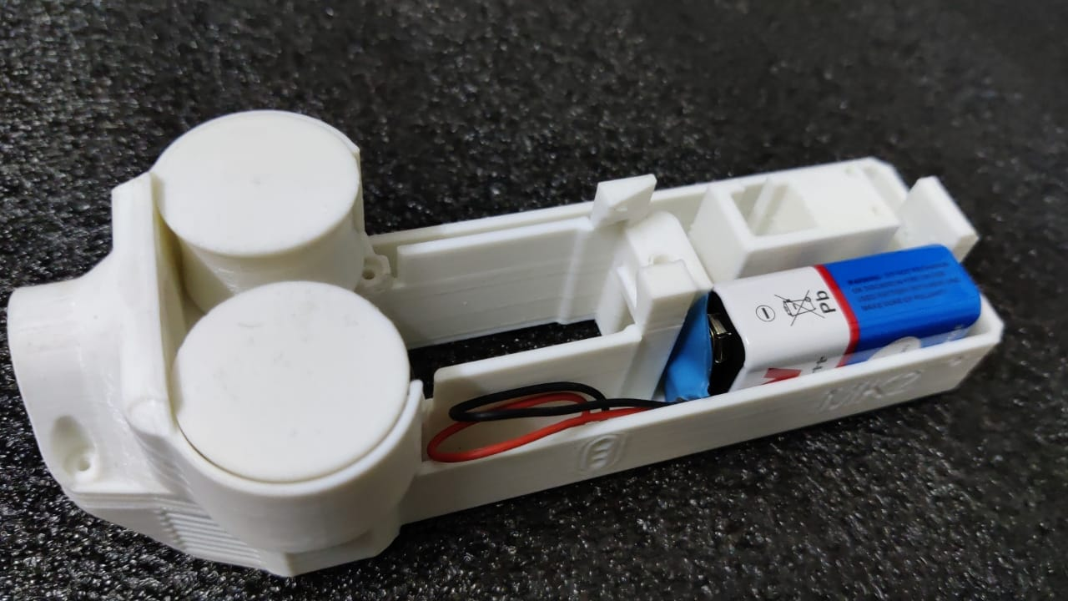
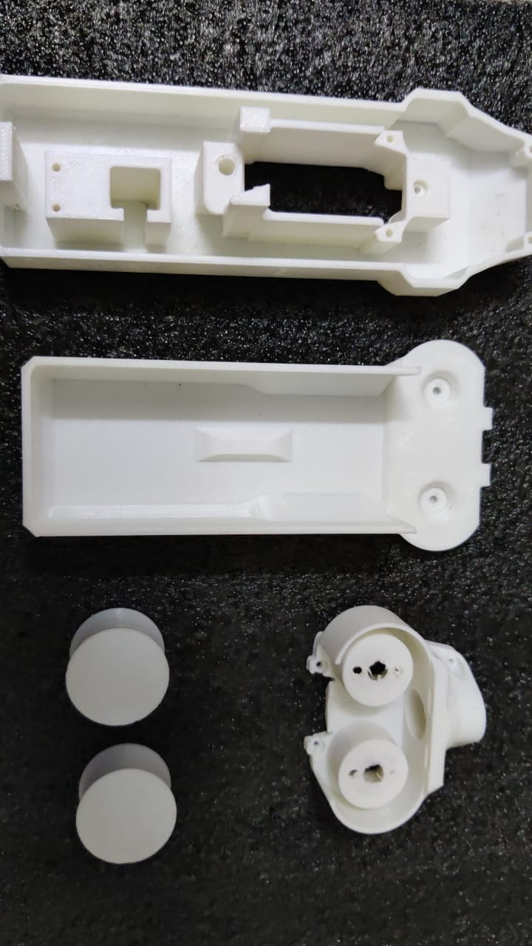
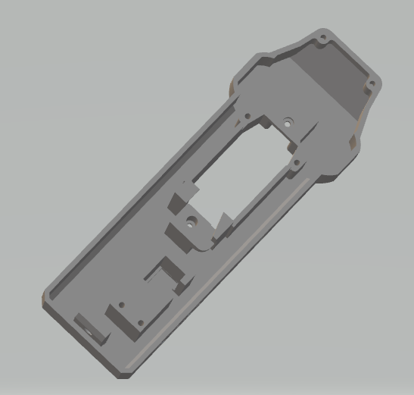
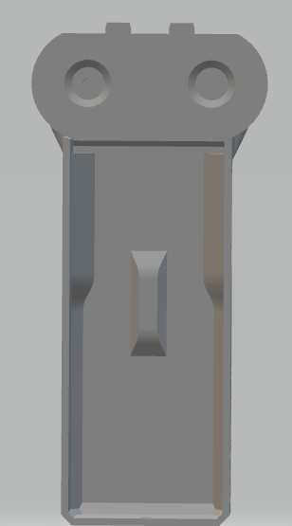
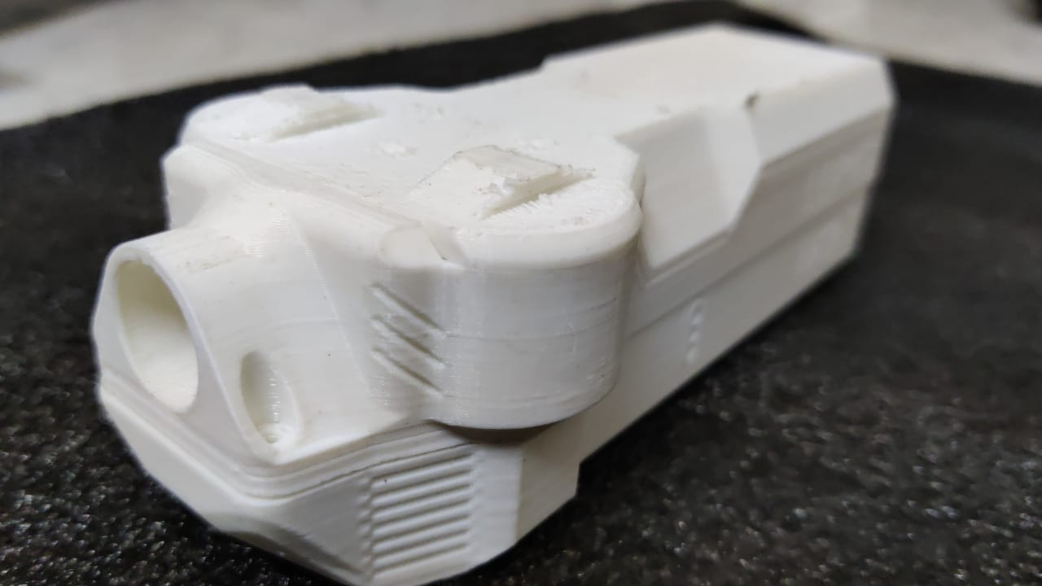
RESULTS
FRD DART GUN (Future Implementation)
3D MODEL

Slide 11
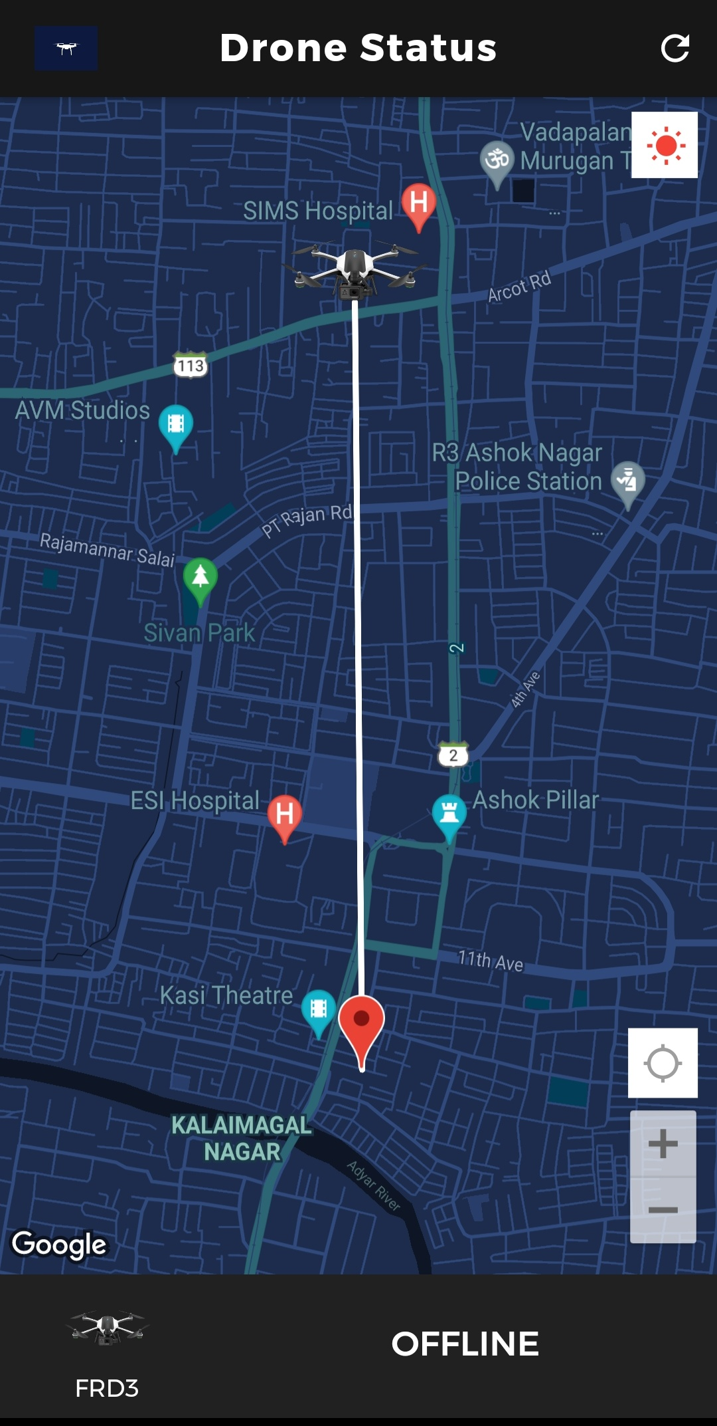


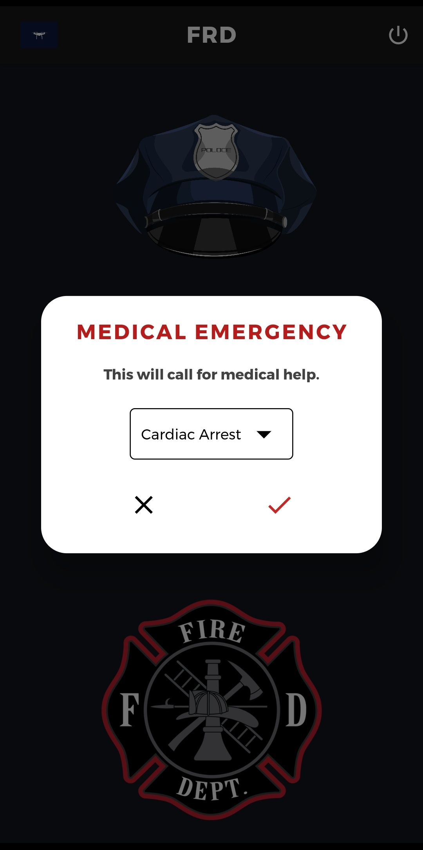
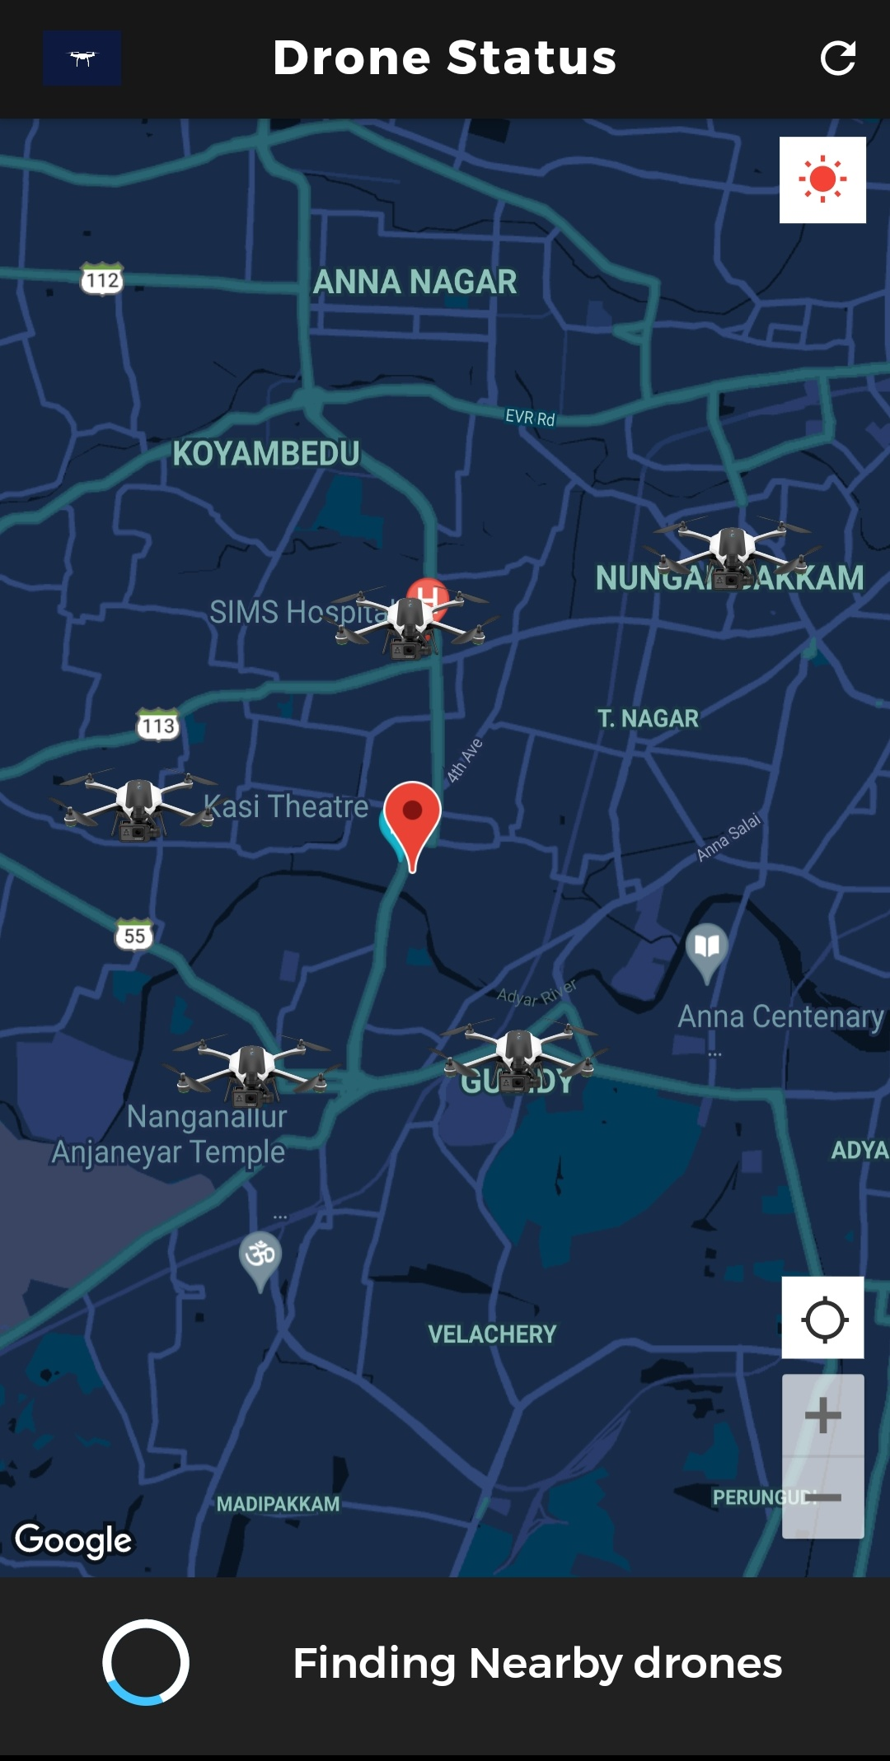
RESULTS
FRD MOBILE APP

Slide 12
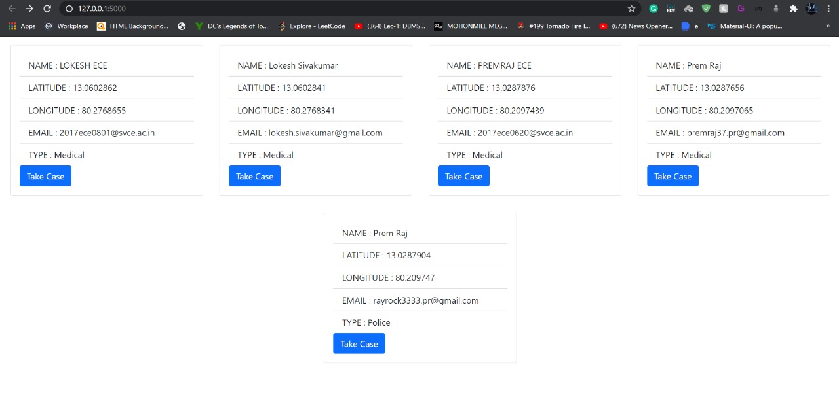
SIMULATED RESULTS
FRD ADMINISTRATOR WEB APP

Slide 13
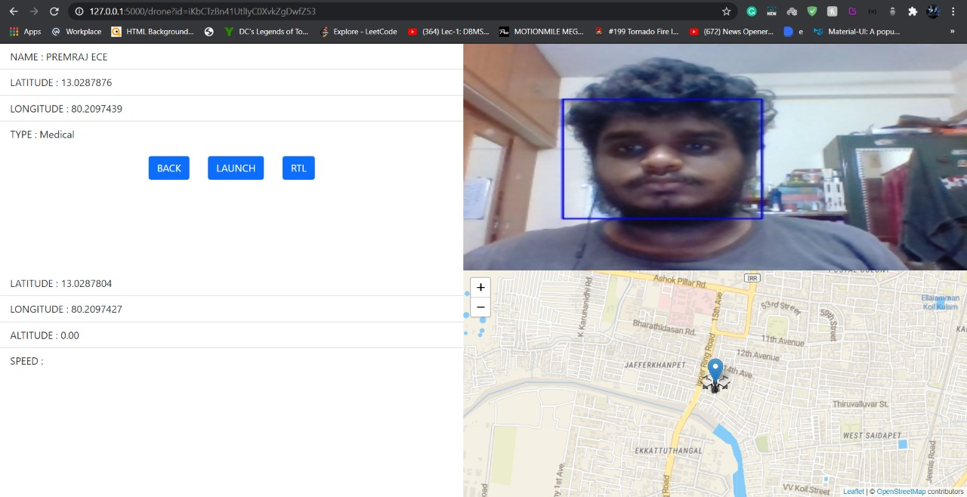
SIMULATED RESULTS
FRD ADMINISTRATOR WEB APP

Slide 14
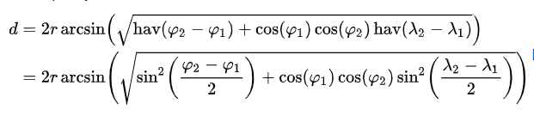
[
RESULTS
AUTONOMOUS FLIGHT APPROACH(Distance Algorithm)
Geodesic distance the shortest path along the ellipsoid of the earth at sea level between one point and another.
Haversine formula:
φ = Latitude
λ = Longitude
r = Radius of Earth
Distance between Emergency Location and FRD’s are mapped and the shortest/closest FRD is assigned to the Emergency Location.

Slide 15
CONCLUSION
The outcome of This project is to propose an innovative addition to the pre-existing UAVs and drones by equipping it with cutting edge autonomy. The features and methodologies proposed will display a significant elevation in terms of performance and efficiency when compared to other UAV’s. The core aspects of the drone are to carry a first aid box in a cold state and provide a bird’s eye view of the situation and autonomous flight. The camera equipped in the drone, provides a live feed to the server which is tapped and being fed to the object detection algorithm in real time stands out compared to other existing models. The autonomous aspect of the drone is a huge plus, this will result in much less response times than the manually controlled UAVs which are available.
As discussed earlier the application of the drone is to provide aid and support to civil service departments like Medical, Police and Fire department in India. However, over the years, the structure of the drones can be enhanced in order to support payloads of greater weight for a longer duration, better implementation of non-lethal weapons and flight path. The future scope of the drone involvement is vast. The FRD will be a valuable piece of technology which can be used to save a lot of lives.

Slide 16
REFERENCES
[1] Piotr Kardasz, Jacek Doskocz, Mateusz Hejduk, Paweł Wiejkut and Hubert Zarzycki in Drones and Possibilities of Their Using, Journal of Civil &amp; Environmental Engineering 2016.
[2] Anna Konert, Jacek Smereka, and Lukasz Szarpak in The Use of Drones in Emergency Medicine: Practical and Legal Aspects, Hindawi Emergency Medicine International Volume 2019.
[3] Kyle Stelmack in Weaponized Police Drones and Their Effect on Police Use of Force, Pittsburgh Journal of Technology, Spring 2015.
[4] Abinesh.D.V, Deepak.A.K in Fire Fighting Drone, IJIERE, Volume 4, Special Issue 1, 2017.
[5] Bhakti Yudho Suprapto, M Ary Heryanto, Herwin Suprijono, Jemie Muliadi, Benyamin Kusumoputro in Design and Development of Heavy-lift Hexacopter for Heavy Payload, iSEMANTIC Conference, 2017.
[6] Dang-Khanh Le, Taek-Kun Nam in A study on the modeling of a hexacopter, Journal of the Korean Society of Marine Engineering (JKOSME), Vol. 39, No. 10 pp. 1023~1030, 2015.
[7] Paul Viola, Michael Jones in Rapid Object Detection using a Boosted Cascade of Simple Feature, Computer Vision and Pattern Recognition conference, 2001.

Slide 17
Write Title here

